Slide 1
Alzheimer's Disease
Harihar Thachapully
Mohammad Ibrahim
Patson D’Souza
Midhun Saminathan

Slide 2
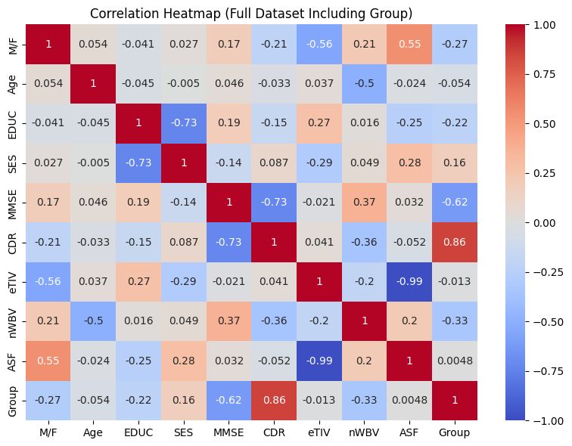
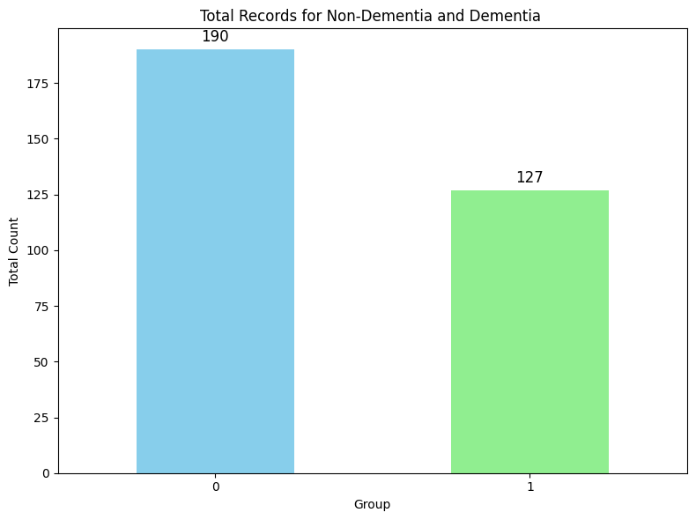
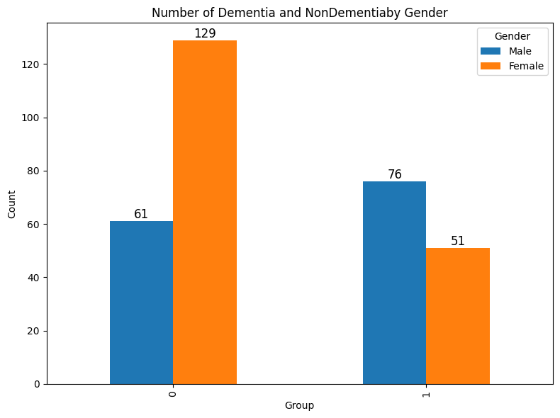
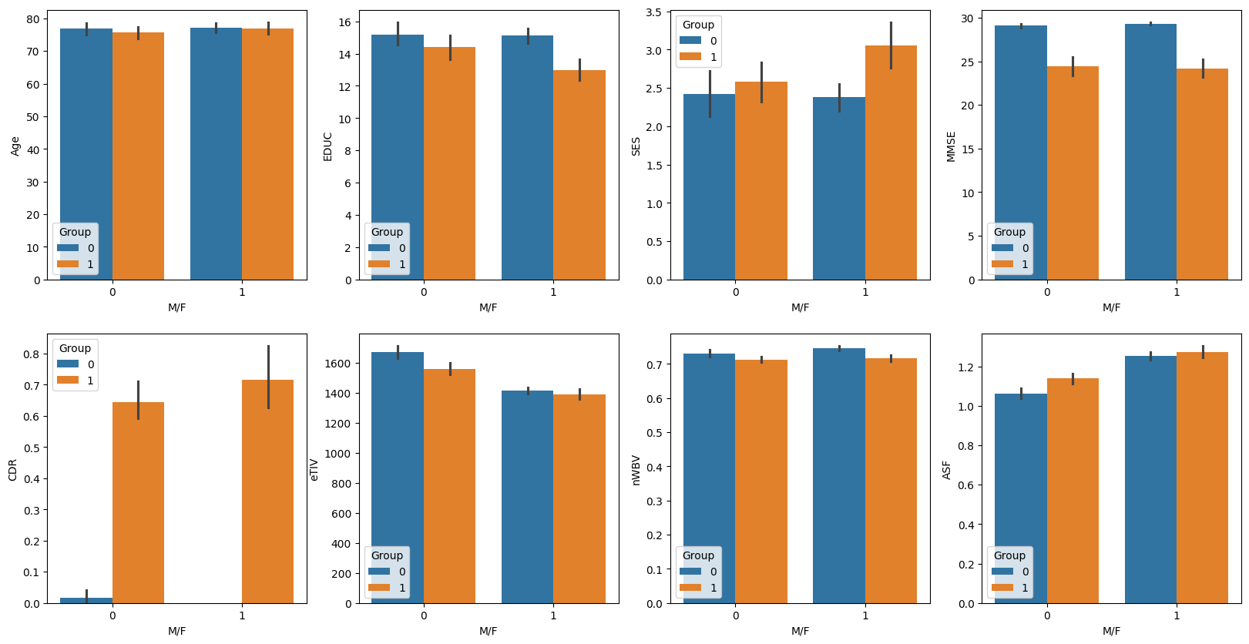
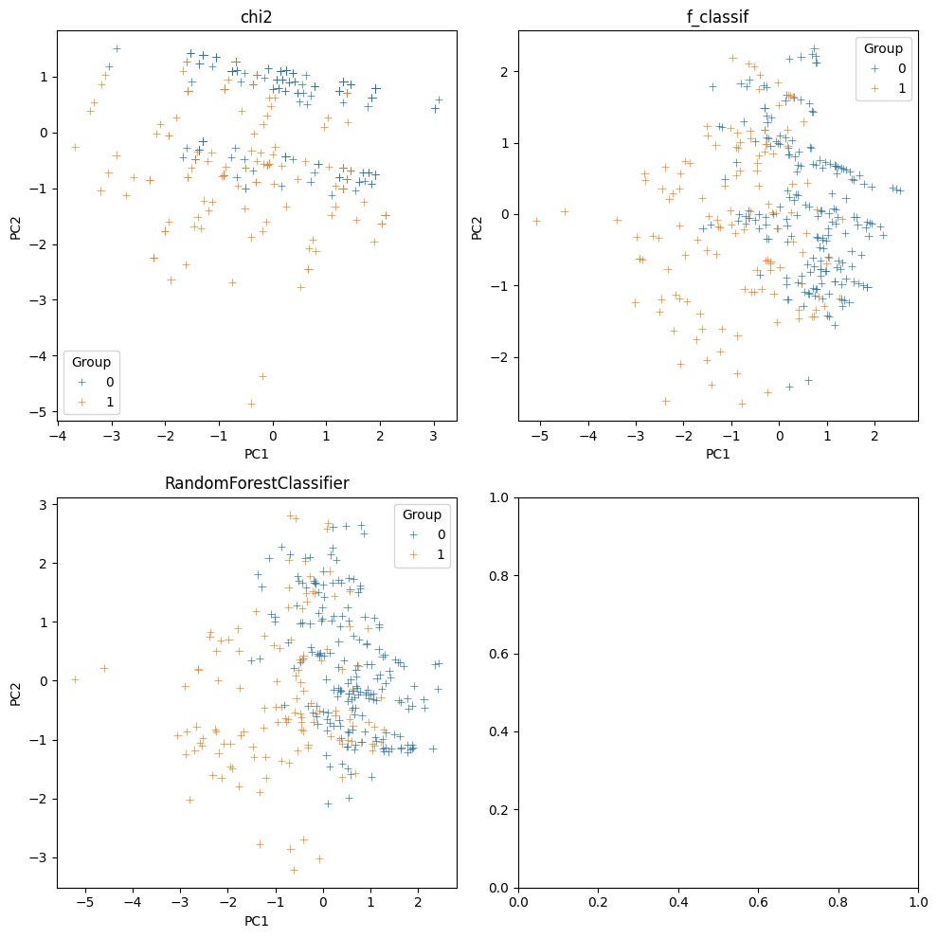
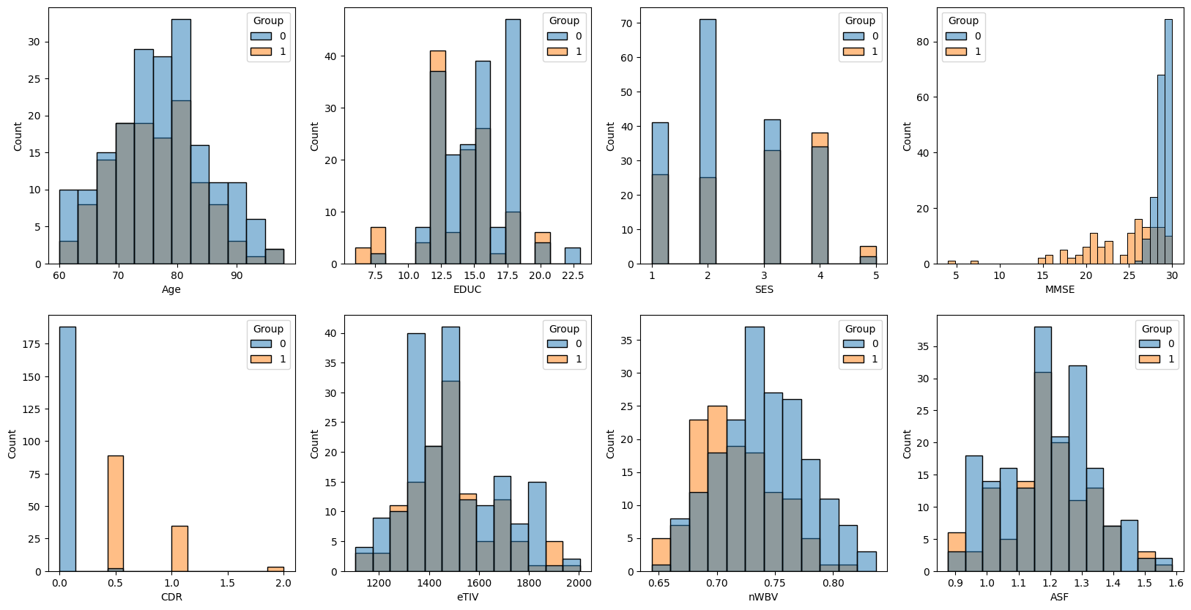
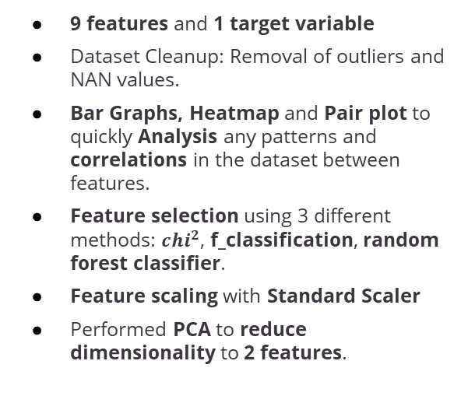
EDA
9 features and 1 target variable
Dataset Cleanup: Removal of outliers and NAN values.
Bar Graphs, Heatmap and Pair plot to quickly Analysis any patterns and correlations in the dataset between features.
Feature selection using 3 different methods: $chi^{2}$, f_classification, random forest classifier.
Feature scaling with Standard Scaler
Performed PCA to reduce dimensionality to 2 features.

Slide 3
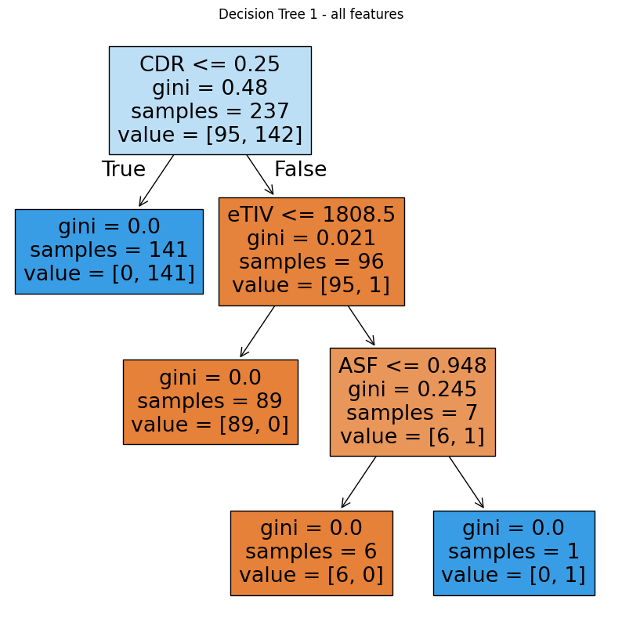
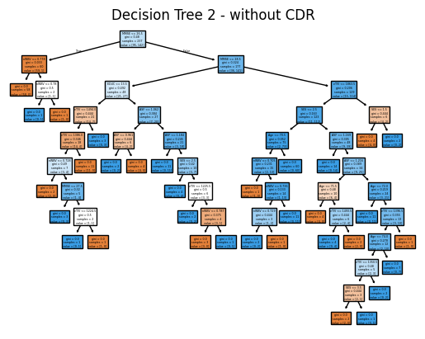
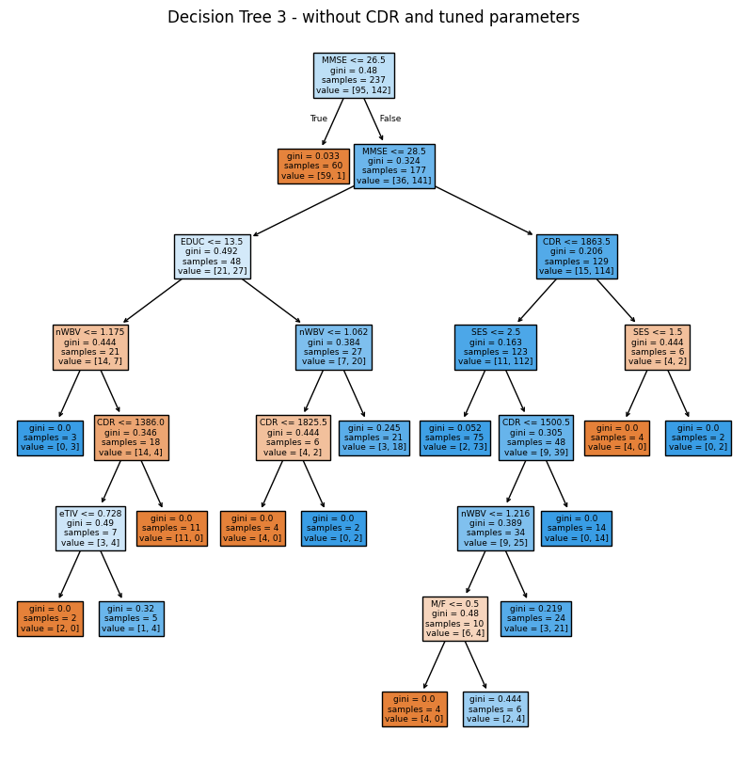
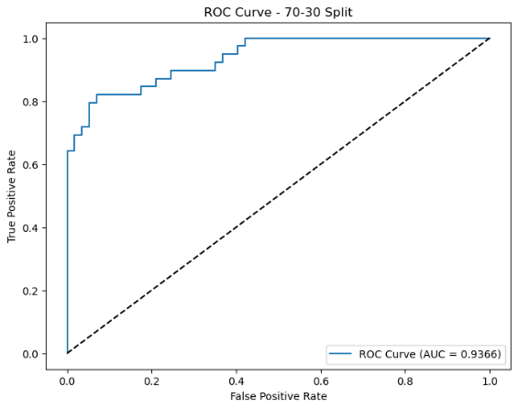
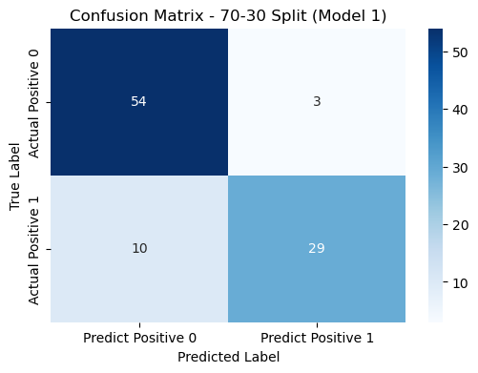

Baseline Models
With CDR
Without CDR
Model | Accuracy
Decision Trees (without CDR) | 85.00%
Random Forrest (without CDR) | 82.63%.
Naïve Bayes (Chi-test without CDR) | 87.5%
MLP ( without CDR) | 87.5%
Linear classifier (without CDR) | 82.8%
98.75%
78.75%
85.00%
Notes:
Compared random forest to decision trees.
When creating a decision tree model using all features, the model performed really well.
The first split in the root node was using the CDR feature. This shows us that CDR was a really good feature
When creating another decision tree model without CDR, the Model was less accurate and the decision tree seems to be over fit.
To get a better decision tree, by tuning the max_leaf_node we were able to get a better accuracy without using CDR
The RF model was used to compare the DT

Slide 4
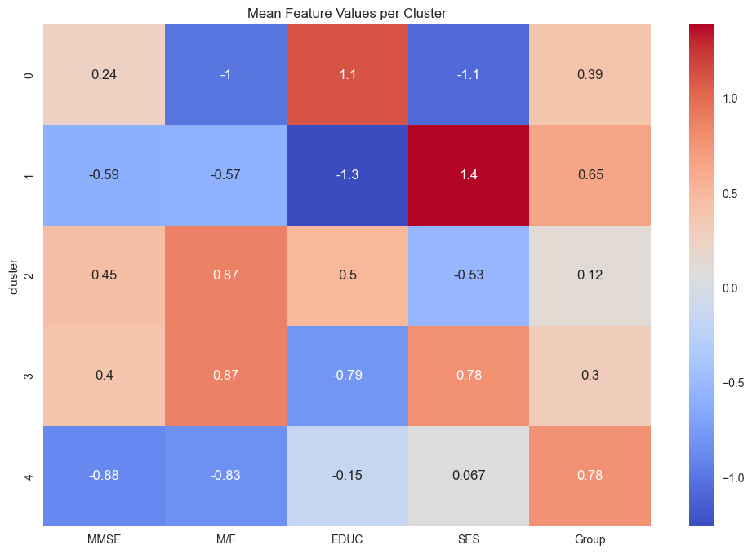
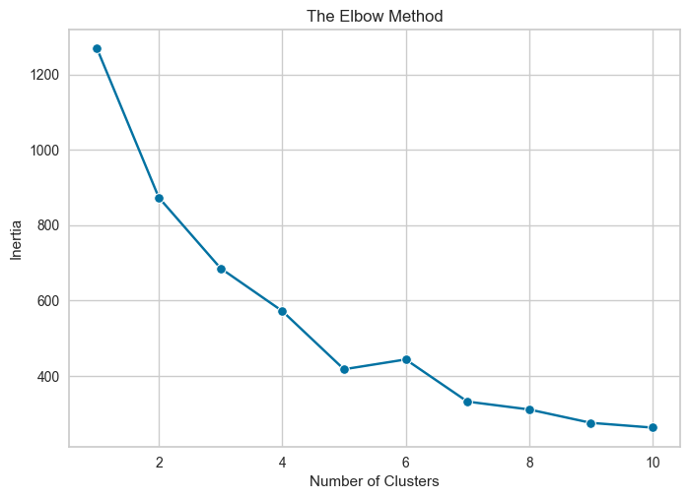
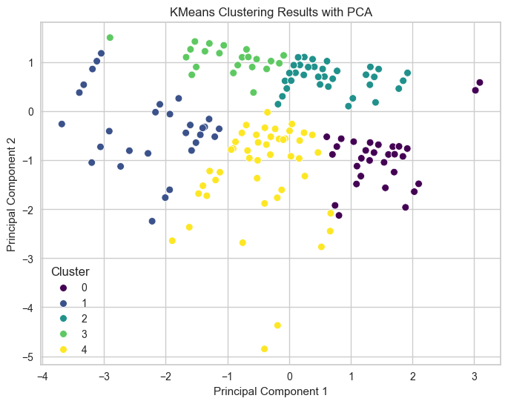
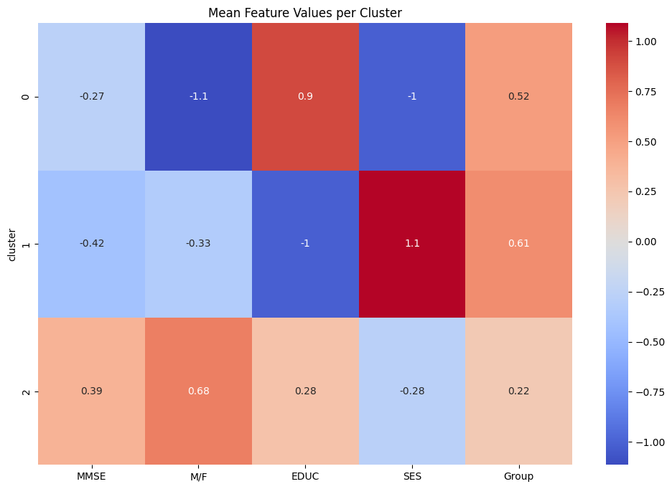
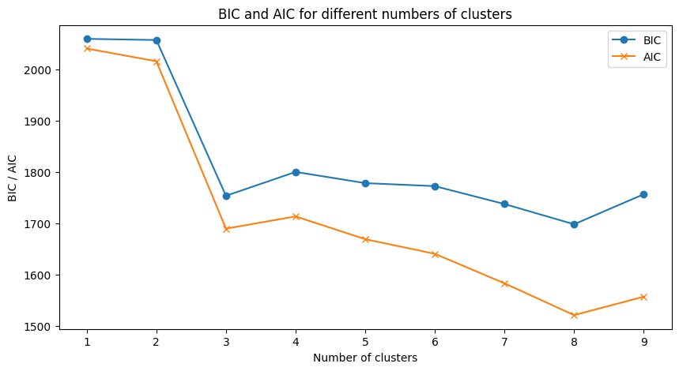
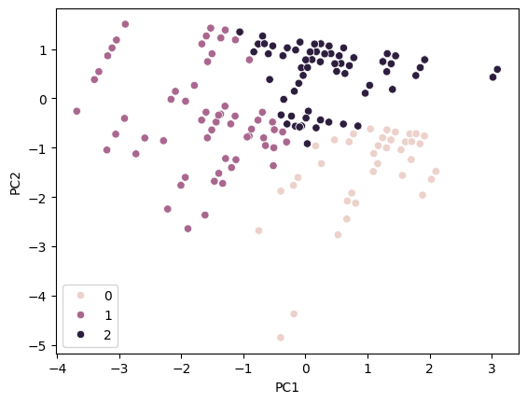
Clustering
KMeans
Number of clusters selected with elbow plot
Check quality of clusters with silhouette score
Make observations based on heatmap correlations
Expectation Maximization with Gaussian Mixture Models
Number of clusters selected with AIC (Akaike Information Criterion) and BIC (Bayesian Information Criterion)
Make observations based on heatmap correlations

Slide 5
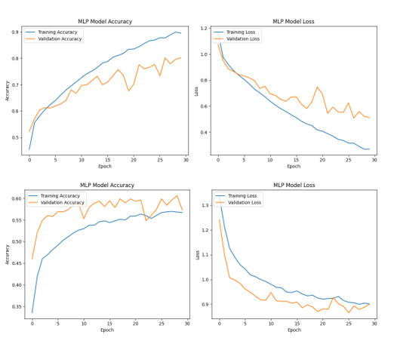
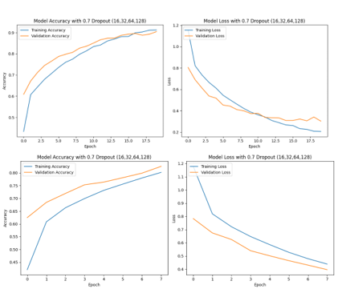
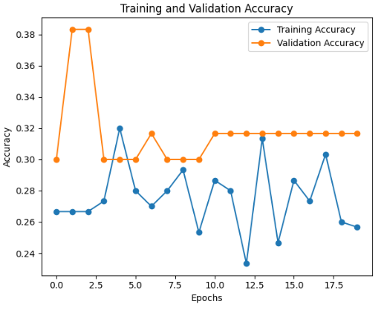
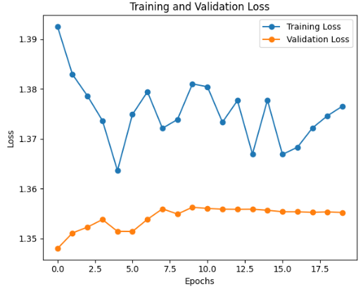
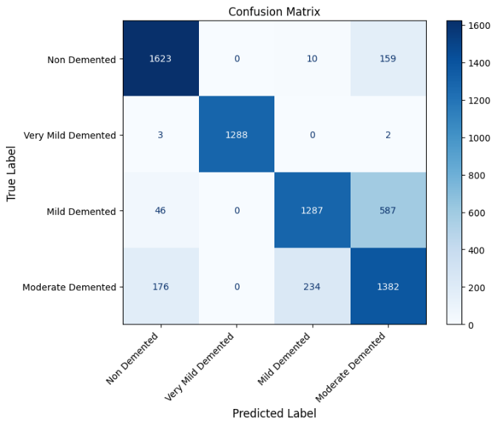

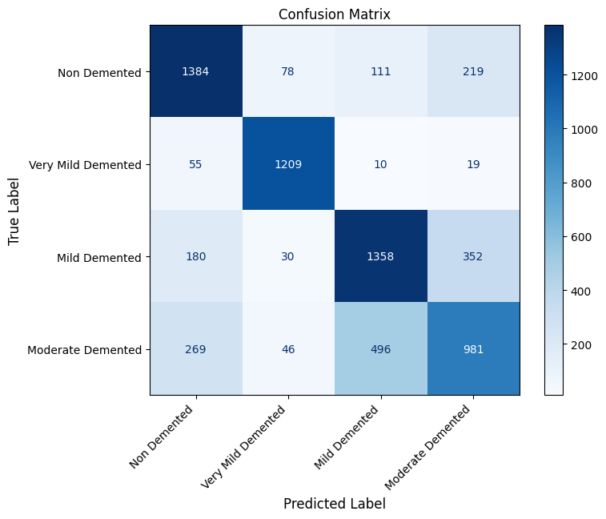
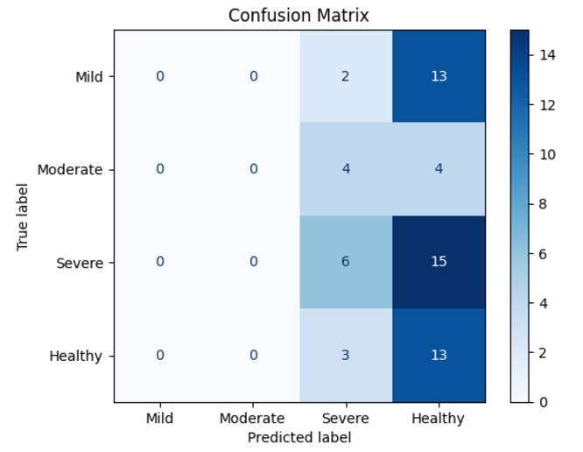
Models Used For Image Dataset
Models Compared: CNN( convolution layers, pooling layers, flatten, dropout, dense layers,) MLP( dense and dropout after flattening)LSTM( LSTM layer, dropout dense SVM( linear or RBF for kernel hyperplane calculation, decision boundaries to classify)
Fine-tuning Details: manually making the architecture, Learning rate, Optimizer, Batch Normalization, Activation functions and a systematic search
Performance: overfitting and underfitting in models and how it affects performance
Challenges: addressing the overfitting and waiting for the long computations to finish to see the results and manually change the architecture
Model | Accuracy
CNN | 90.67%
MLP – Image Dataset | 72.24%
SVM (average OvO) | 79.06%
LSTM | 32%

Slide 6
Conclusion
Model | Performance with tabular dataset | Limitations
Decision Trees | Excellent performance when using CDR for training, and with adequete adjustments to the tree structure it can classify well without CDR. | It is sensitive to noisy data and prone to overfitting
Random Forrest | Great at generalizing the data and performs well | It is complex to interpret the Random forest, unlike decision tree graphs
Naïve Bayes | Performed well with the data set as data is not strongly corelated | Performance could have been affected because some of the features were not normally distributed
MLP | Good performance on non-linear patterns in data due to non-linear activation functions. | Performs better with more data
Linear classifier | Performs well on data that was well separated. | Less effective than MLP due to being limited to modeling linear relationships and cannot handle non-linearly separable data.
Model | Performance with image dataset | Limitations
CNN | Best for images | Computationally as layers increase expensive
MLP | Simple and fast | Does not capture features as well as CNN.
SVM | Effective and easy | Binary classification and is hard when there are overlapping classes
LSTM | Ineffective | Depends on sequential data. Did not perform well on images.

